Slide 1
Madhankumar PORTFOLIO
Presentation by my portfolio website

Slide 2
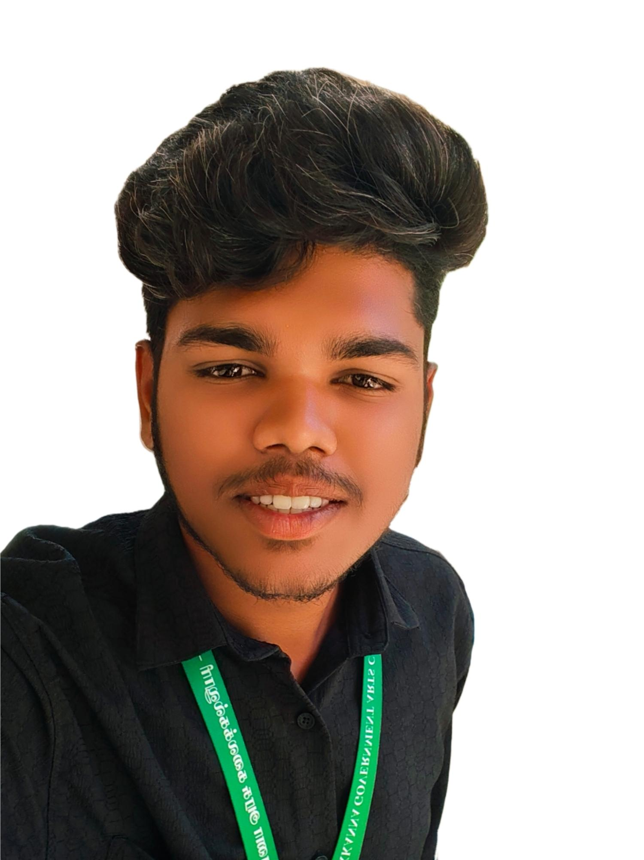
Digital portfolio
Name : Madhankumar M
Register No/NM ID:2422k1943/asbru062422k1943
Department : computer scienc
College/University : chikkanna government arts college /
Bharathiyar University

Slide 3
Agenda
• Problem Statement • Project Overview • End Users • Tools and Technologies • Portfolio Design and Layout • Features and Functionality • Results and Screenshots • Conclusion • GitHub Link

Slide 4
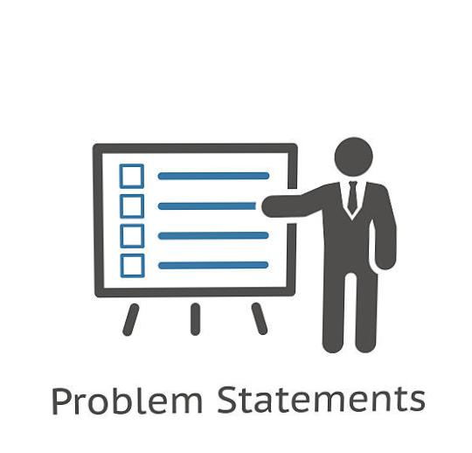
Problem statement
Many freshers and students struggle to showcase their skills, projects, and services in a professional way. Without a portfolio, it is hard to create a strong first impression for clients or recruiters. I created this personal portfolio website to present my skills, projects, and services in an attractive format. It helps me highlight my abilities in web development, UI/UX design, and programming. This website solves the problem of visibility by acting as my digital identity and resume.

Slide 5
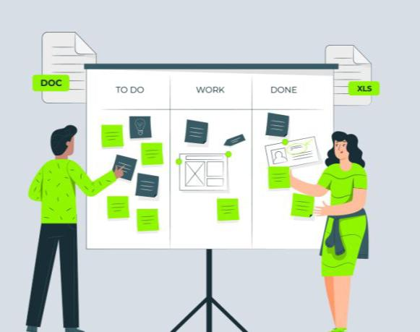
Project overview
This portfolio website is designed to showcase my skills and academic projects. It provides a structured platform with sections like Home, About, Skills, Portfolio, and Contact. The website highlights my strengths in web development, UI/UX design, and programming It is responsive, user-friendly, and uses modern design elements for better presentation. The goal is to create a professional digital identity for career opportunities.

Slide 6

End users
1. Students who want to showcase their academic projects. 2. Freshers preparing for job opportunities. 3. Recruiters looking for candidate portfolios. 4. Clients searching for web/UI design services. 5. Anyone interested in my skills and digital profile.

Slide 7

Tools & technologies
1. HTML5 – for website structure. 2. CSS3 – for styling and responsive design. 3. JavaScript – for interactivity and transitions. 4. Responsive Design – ensures mobile & desktop support. 5. UI/UX Principles – to improve user experience.

Slide 8

Portfolio design & layout
1. Clean and modern interface with simple navigation. 2. Homepage highlights profile and introduction. 3. Separate pages for About, Skills, Projects, and Contact. 4. Responsive grid layout for desktop and mobile views. 5. Balanced use of colors, typography, and visuals.

Slide 9

Features & Functionality
1. Interactive navigation with smooth transitions. 2. Responsive design for all devices. 3. Dedicated sections for skills, projects, and contact. 4. Animated buttons and hover effects for better UI. 5. Contact form for easy communication.

Slide 10
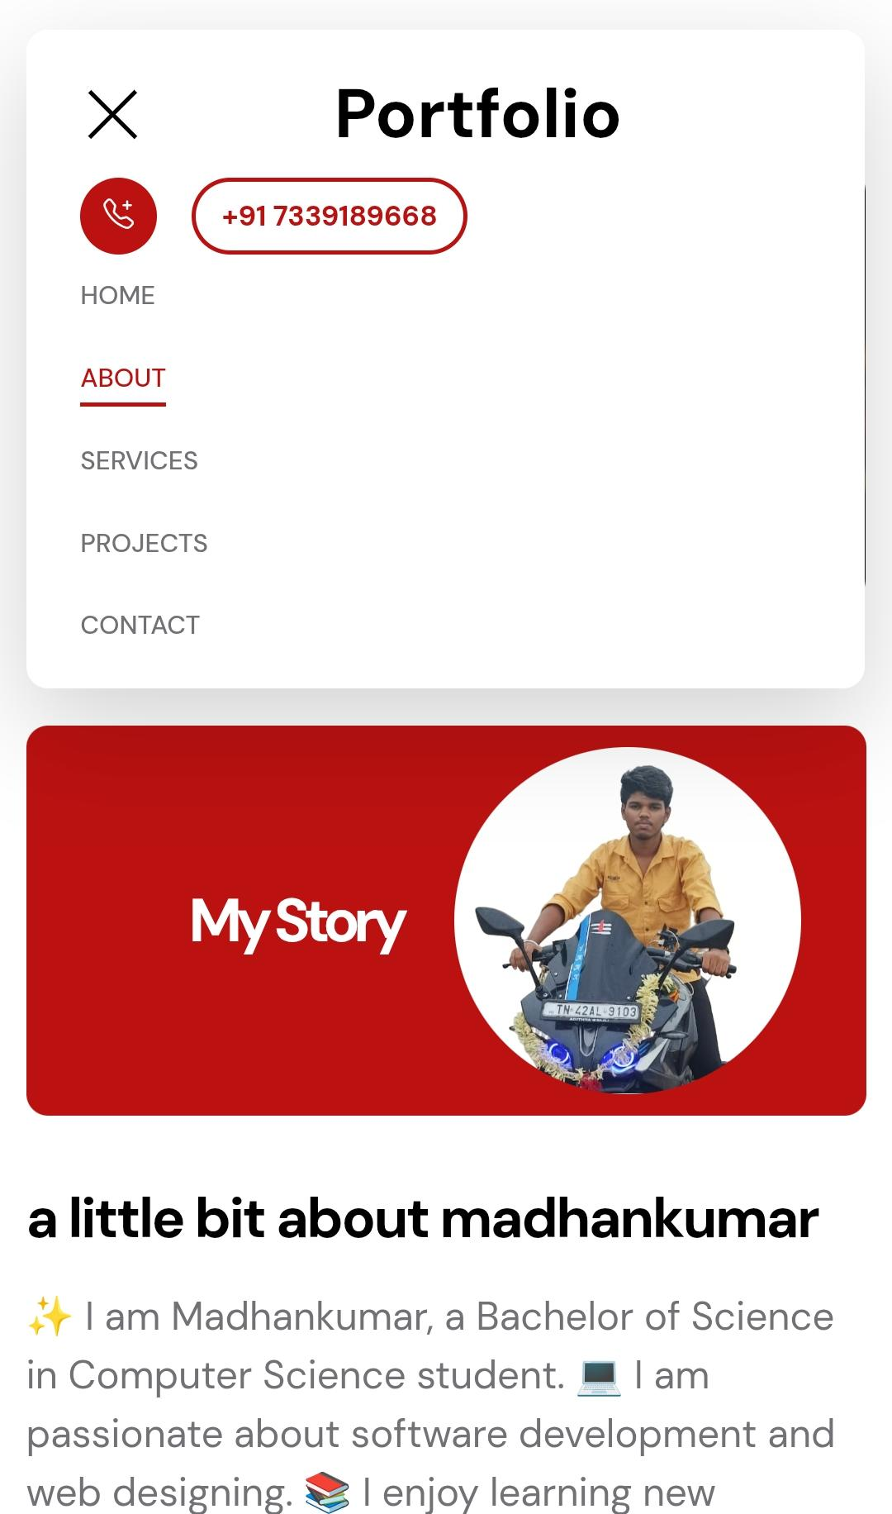
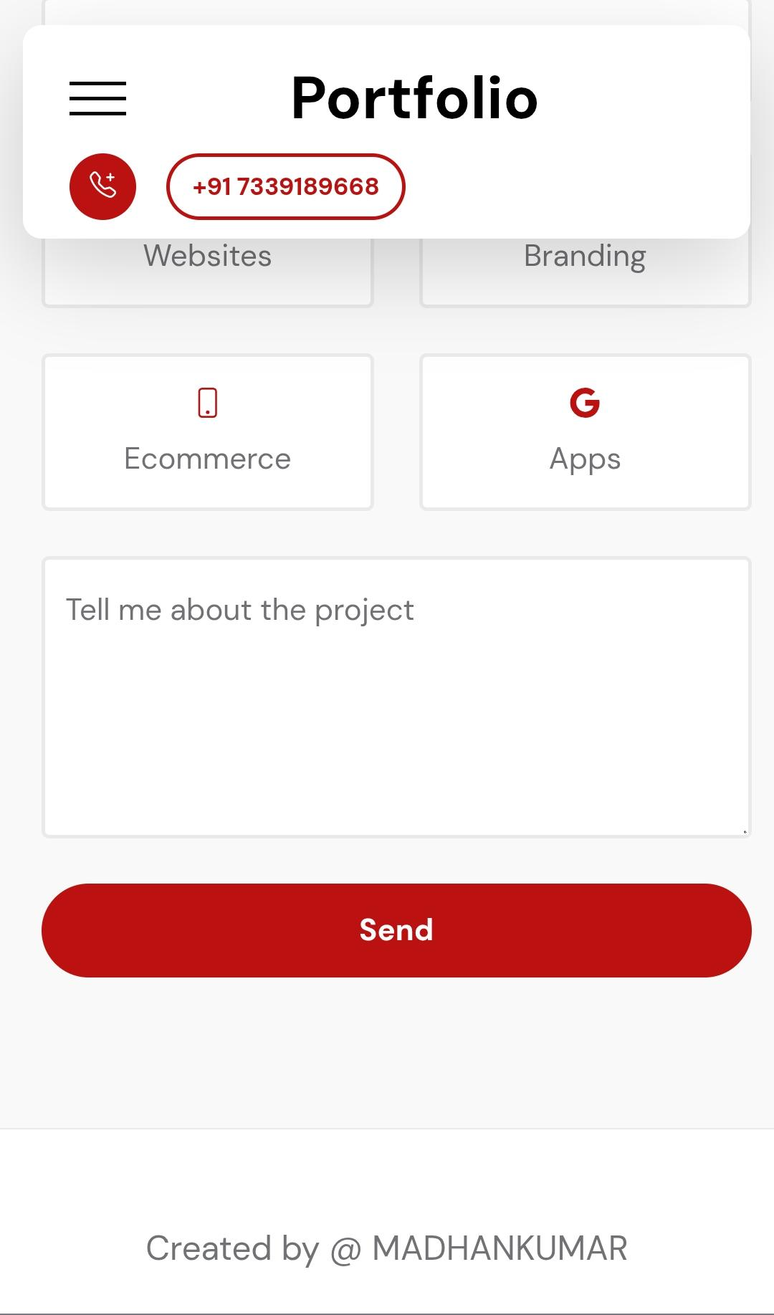
Results & screenshots
1. Completed portfolio website. 2. Responsive and user-friendly design. 3. Clear display of skills and projects. 4. Modern layout with smooth UI. 5. Screenshots show final output.

Slide 11

Conclusion
1. Created a professional portfolio website. 2. Showcases skills, projects, and achievements. 3. Ensures responsive and user-friendly design. 4. Acts as my digital identity for career growth. 5. Provides scope for future improvements.

Slide 12
Thank you

